Slide 1
Welcome to1st Grade
Please sign in, and find the desk with your students name on it

Slide 2
Notes:
Thank you all so much for the classroom materials! We have received so much that we do not need anymore! We are so grateful. Additionally, I appreciate all the parent volunteer sheets that have returned. I will reach out a with a schedule in the next few days.

Slide 4
Dojo is a positive reinforcement tool.
10 points by Friday = 1 ticket, 20 points by Friday = 2 tickets, 30 points by Friday = 3 tickets.
Tickets can be exchanged for fun rewards.
Families can track points.
Download on a cell phone, computer, or iPad using the QR code you received.

Slide 5
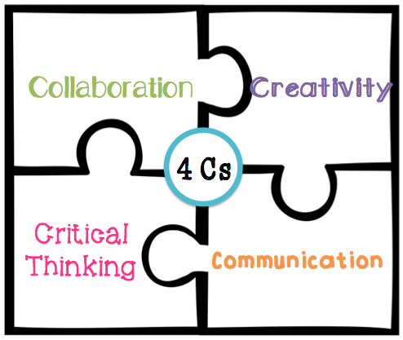
What do we learn in first grade?
Language Arts: Journeys
Math: My Math
Science: Mystery Science,
STEAM challenges
Social Studies: Growth
Mindset, and Studies Weekly
Physical Education: 200 minutes/ 10 days
(20 mins. daily)
Additional: Art, Library, Music, Maker space, Buddy Reading

Slide 6
SeeSaw is a learning journal where the students can show what they know through photos, drawings, text, videos, and recordings.
You can download SeeSaw app and connect to their students SeeSaw journal using the QR code on the desk.
You can leave voice and text comments on their students work for them to see!
This is a great way to keep families connected to what is going on in the classroom.
PLEASE CONNECT AS SOON AS POSSIBLE ☺

Slide 7
Homework
Math sent home is practice, I would strongly encourage that you help your child complete it, but it does not need to be turned in.
Read 20 minutes a night with or to your student (THIS IS SO IMPORTANT!).
Practice sight words weekly (each set is on our webpage)
Practice spelling words weekly (we will begin spelling the week of September 1st.)
BE A KID – PLAY – BE ACTVIE – BE WITH FAMILY

Slide 8
Share
Each student will have a specific share day of the week. That will be the day they are allowed to bring share each week on that day.
The list is on the webpage, as well as printed out on your students table.
If your students share day falls on a no school day they are welcome to bring their share the day before.

Slide 9
Contact Me
Class webpage: 1stgrademvit.weebly.com
Class Dojo: Directions to connect on desk
SeeSaw: Directions to connect on desk
Email: carly.wilson@simivalleyusd.org
Phone: Call the office at (805)-520-6110

Slide 10
I appreciate you being here! Please feel free to look around and ask me if you have any remaining questions.

